Slide 1
Chapter 4:
Making Decisions
Brief Version of Starting Out with C++, 5/e
by Tony Gaddis and Barret Krupnow

Slide 2
4.1
Relational Operators

Slide 3
Relational Operators
Used to compare numbers to determine relative order
Operators:
> | Greater than
< | Less than
>= | Greater than or equal to
<= | Less than or equal to
== | Equal to
!= | Not equal to

Slide 4
Relational Expressions
Boolean expressions – true or false
Examples:
  12 > 5 is true
  7 <= 5 is false
  if x is 10, then
  x == 10 is true,
  x != 8 is true, and
  x == 8 is false

Slide 5
Relational Expressions
Can be assigned to a variable:
  result = x <= y;
Assigns 0 for false, 1 for true
Do not confuse = and ==

Slide 6
4.2
The if Statement

Slide 7
The if Statement
Allows statements to be conditionally executed or skipped over
Models the way we mentally evaluate situations:
  "If it is raining, take an umbrella."
  "If it is cold outside, wear a coat."

Slide 8
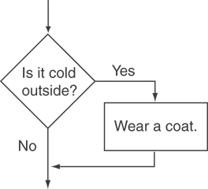
Flowchart for Evaluating a Decision

Slide 9
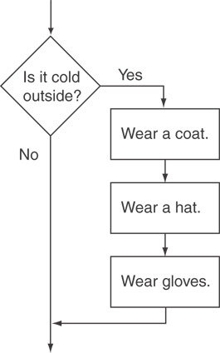
Flowchart for Evaluating a Decision

Slide 10
The if Statement
General Format:
  if (expression)
  statement;

Slide 11
if statement – what happens
To evaluate:
  if (expression)
  statement;
If the expression is true, then statement is executed.
If the expression is false, then statement is skipped.

Slide 12
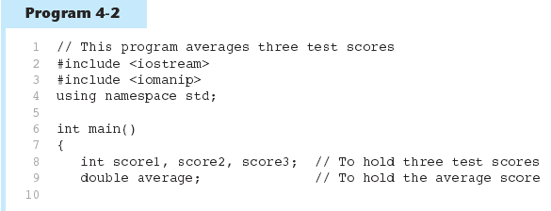
(Program Continues)

Slide 13
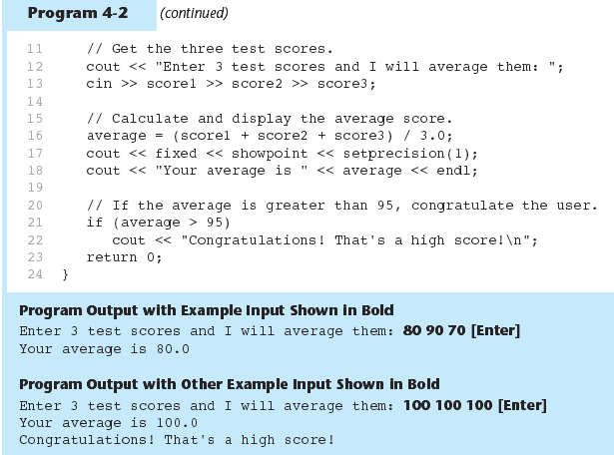

Slide 14
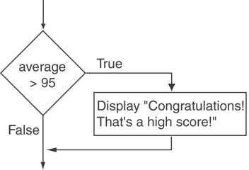
Flowchart for Lines 21 and 22

Slide 15
if statement notes
Do not place ; after (expression)
Place statement; on a separate line after (expression), indented:
  if (score > 90)
  grade = 'A';
Be careful testing floats and doubles for equality
0 is false; any other value is true

Slide 16
4.3
Flags

Slide 17
Flags
Variable that signals a condition
Usually implemented as a bool variable
As with other variables in functions, must be assigned an initial value before it is used

Slide 18
4.4
Expanding the if Statement

Slide 19
Expanding the if Statement
To execute more than one statement as part of an if statement, enclose them in { }:
  if (score > 90)
  {
  grade = 'A';
  cout << "Good Job!\n";
  }
{ } creates a block of code

Slide 20
4.5
The if/else Statement

Slide 21
The if/else Statement
Provides two possible paths of execution
Performs one statement or block if the expression is true, otherwise performs another statement or block.

Slide 22
The if/else Statement
General Format:
  if (expression)
  statement1; // or block
  else
  statement2; // or block

Slide 23
if/else – what happens
To evaluate:
  if (expression)
  statement1;
  else
  statement2;
If the expression is true, then statement1 is executed and statement2 is skipped.
If the expression is false, then statement1 is skipped and statement2 is executed.

Slide 24
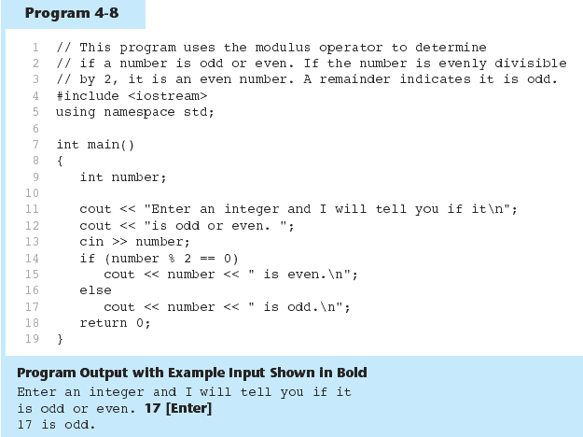

Slide 25
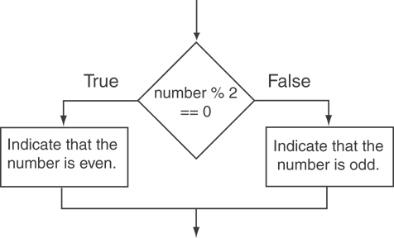
Flowchart for Lines 14 through 18

Slide 26
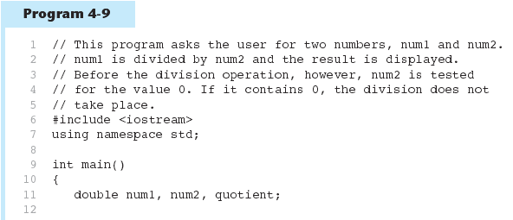
(Program Continues)

Slide 27
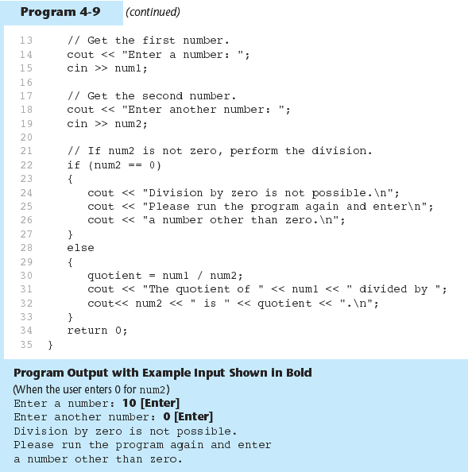

Slide 28
4.6
The if/else if Statement

Slide 29
The if/else if Statement
Chain of if statements that test in order until one is found to be true
Also models thought processes:
  “If it is raining, take an umbrella,
  else, if it is windy, take a hat,
  else, take sunglasses”

Slide 30
if/else if format
  if (expression)
  statement1; // or block
  else if (expression)
  statement2; // or block
  .
  . // other else ifs .
  else if (expression)
  statementn; // or block

Slide 31
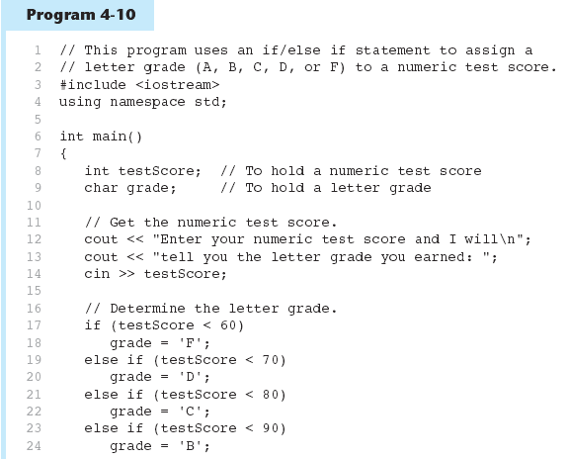
(Program Continues)

Slide 32
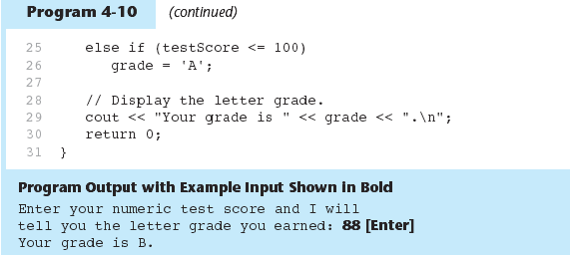

Slide 33
4.7
Using a Trailing else

Slide 34
Using a Trailing else
Used with if/else if statement when none of the expressions are true
Provides default statement/action
Used to catch invalid values, other exceptional situations

Slide 35
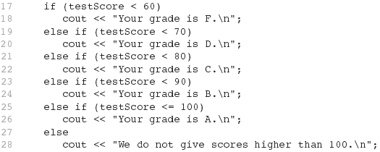
From Program 4-12

Slide 36
4.8
Menus

Slide 37
Menus
Menu-driven program: program execution controlled by user selecting from a list of actions
Menu: list of choices on the screen
Menus can be implemented using if/else if statements

Slide 38
Menu-driven program organization
Display list of numbered or lettered choices for actions
Prompt user to make selection
Test user selection in expression
  if a match, then execute code for action
  if not, then go on to next expression

Slide 39
4.9
Nested if Statements

Slide 40
Nested if Statements
An if statement that is part of the if or else part of another if statement
Can be used to evaluate more than one condition:
  if (score < 100)
  {
  if (score > 90)
  grade = 'A';
  }

Slide 41
Notes on coding nested ifs
An else matches the nearest if that does not have an else:
  if (score < 100)
  if (score > 90)
  grade = 'A';
  else ...// goes with second if,
  // not first one
Proper indentation helps greatly

Slide 42
4.10
Logical Operators

Slide 43
Logical Operators
Used to create relational expressions from other relational expressions
Operators, meaning, and explanation:
&& | AND | New relational expression is true if both expressions are true
|| | OR | New relational expression is true if either expression is true
! | NOT | Reverses the value of an expression – true expression becomes false, and false becomes true

Slide 44
Logical Operators - examples
int x = 12, y = 5, z = -4;
(x > y) && (y > z) | true
(x > y) && (z > y) | false
(x <= z) || (y == z) | false
(x <= z) || (y != z) | true
!(x >= z) | false

Slide 45
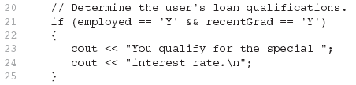
The && Operator in Program 4-16

Slide 46

The || Operator in Program 4-17

Slide 47

The ! Operator in Program 4-18

Slide 48
Logical Operators - notes
! has highest precedence, followed by &&, then ||
If the value of an expression can be determined by evaluating just the sub-expression on left side of a logical operator, then the sub-expression on the right side will not be evaluated (short circuit evaluation)

Slide 49
4.11
Checking Numeric Ranges with Logical Operators

Slide 50
Checking Numeric Ranges with Logical Operators
Used to test to see if a value falls inside a range:
  if (grade >= 0 && grade <= 100)
  cout << "Valid grade";
Can also test to see if value falls outside of range:
  if (grade <= 0 || grade >= 100)
  cout << "Invalid grade";
Cannot use mathematical notation:
  if (0 <= grade <= 100) //doesn’t work!

Slide 51
4.12
Validating User Input

Slide 52
Validating User Input
Input validation: inspecting input data to determine whether it is acceptable
Bad output will be produced from bad input
Can perform various tests:
  Range
  Reasonableness
  Valid menu choice
  Divide by zero

Slide 53
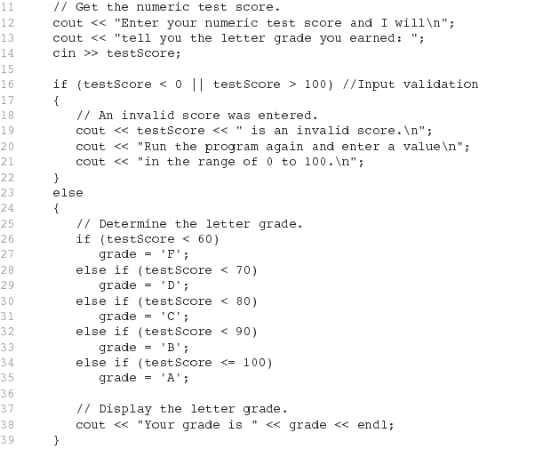
From Program 4-19

Slide 54
4.13
More About Variable Definitions and Scope

Slide 55
More About Variable Definitions and Scope
Scope of a variable is the block in which it is defined, from the point of definition to the end of the block
Usually defined at beginning of function
May be defined close to first use

Slide 56
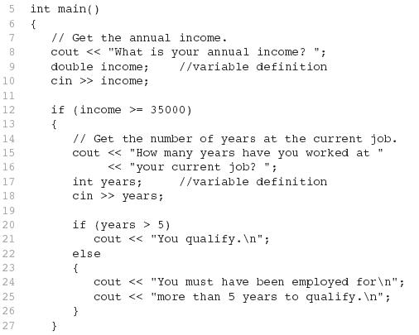
From Program 4-21

Slide 57
Still More About Variable Definitions and Scope
Variables defined inside { } have local or block scope
When inside a block within another block, can define variables with the same name as in the outer block.
  When in inner block, outer definition is not available
  Not a good idea

Slide 58
4.14
Comparing Strings

Slide 59
Comparing Strings
You cannot use relational operators with C-strings
Must use the strcmp function to compare C-strings
strcmp compares the ASCII codes of the characters in the C-strings. Comparison is character-by-character

Slide 60
Comparing Strings
The expression
strcmp(str1, str2)
compares the strings str1 and str2
    It returns 0 if the strings are the same
    It returns a negative number if str1 < str2
    It returns a positive number if str1 > str2

Slide 61
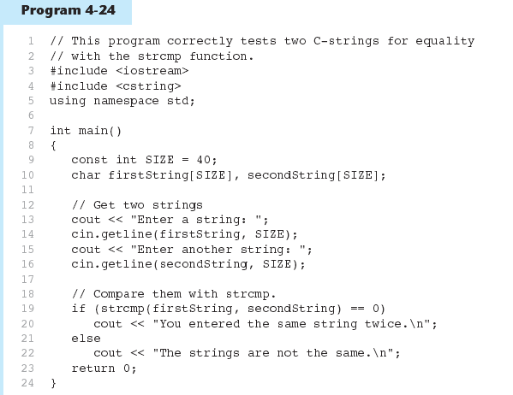

Slide 62


Slide 63
4.15
The Conditional Operator

Slide 64
The Conditional Operator
Can use to create short if/else statements
Format: expr ? expr : expr;
x<0 ? y=10 : z=20;
First Expression:
Expression to be
tested
2nd Expression:
Executes if first
expression is true
3rd Expression:
Executes if the first
expression is false

Slide 65
The Conditional Operator
The value of a conditional expression is
  The value of the second expression if the first expression is true
  The value of the third expression if the first expression is false
Parentheses () may be needed in an expression due to precedence of conditional operator

Slide 66
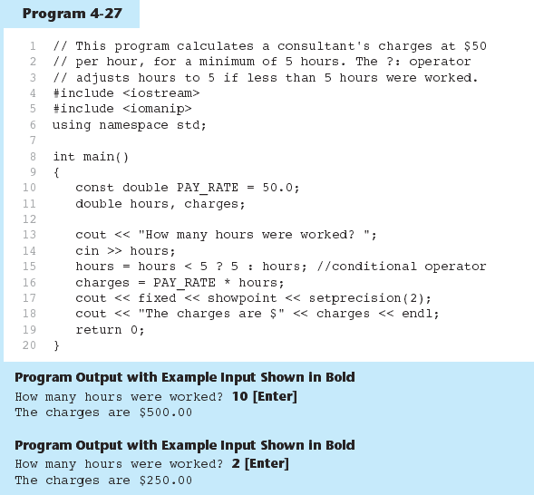

Slide 67
4.16
The switch Statement

Slide 68
The switch Statement
Used to select among statements from several alternatives
In some cases, can be used instead of if/else if statements

Slide 69
switch statement format
switch (expression) //integer
{
case exp1: statement1;
case exp2: statement2;
...
case expn: statementn;
default: statementn+1;
}

Slide 70
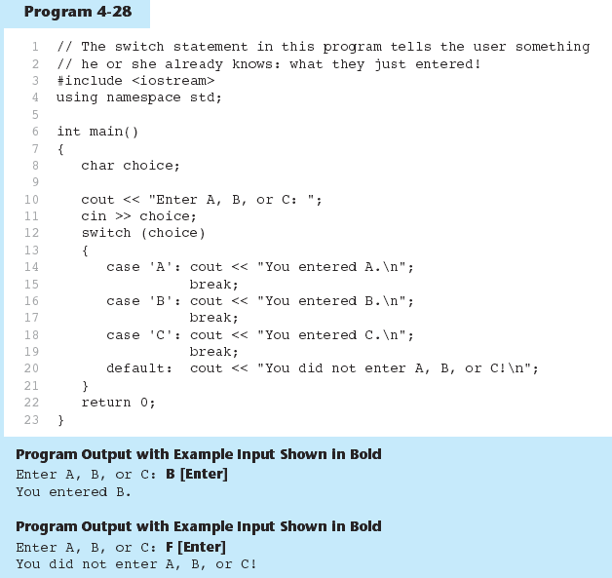

Slide 71
switch statement requirements
1) expression must be an integer variable or an expression that evaluates to an integer value
exp1 through expn must be constant integer expressions or literals, and must be unique in the switch statement
default is optional but recommended

Slide 72
switch statement – how it works
1) expression is evaluated
The value of expression is compared against exp1 through expn.
If expression matches value expi, the program branches to the statement following expi and continues to the end of the switch
If no matching value is found, the program branches to the statement after default:

Slide 73
break statement
Used to exit a switch statement
If it is left out, the program "falls through" the remaining statements in the switch statement

Slide 74
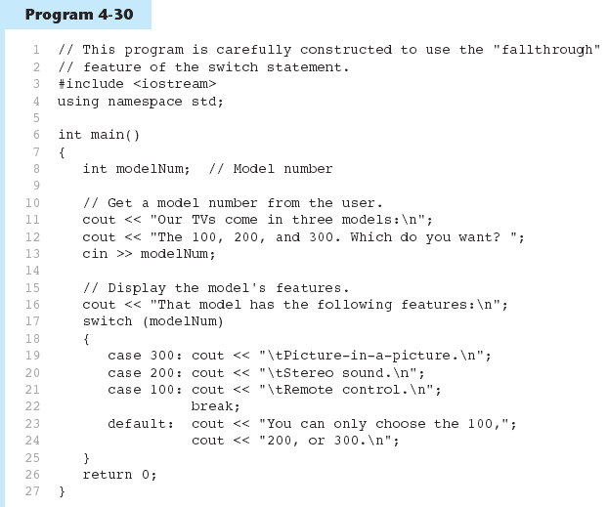

Slide 75
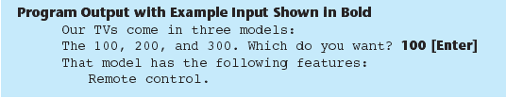
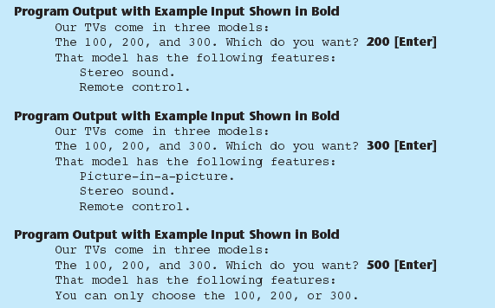

Slide 76
Using switch with a menu
switch statement is a natural choice for menu-driven program:
  display the menu
  then, get the user's menu selection
  use user input as expression in switch statement
  use menu choices as expr in case statements

Slide 77
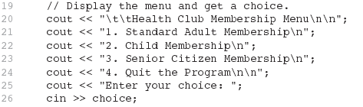
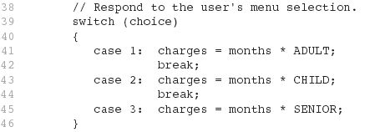
From Program 4-32

Slide 78
4.17
Testing for File Open Errors

Slide 79
Testing for File Open Errors
Can test a file stream object to detect if an open operation failed:
  infile.open("test.txt");
  if (!infile)
  {
  cout << "File open failure!";
  }
Can also use the fail member function

